Slide 1
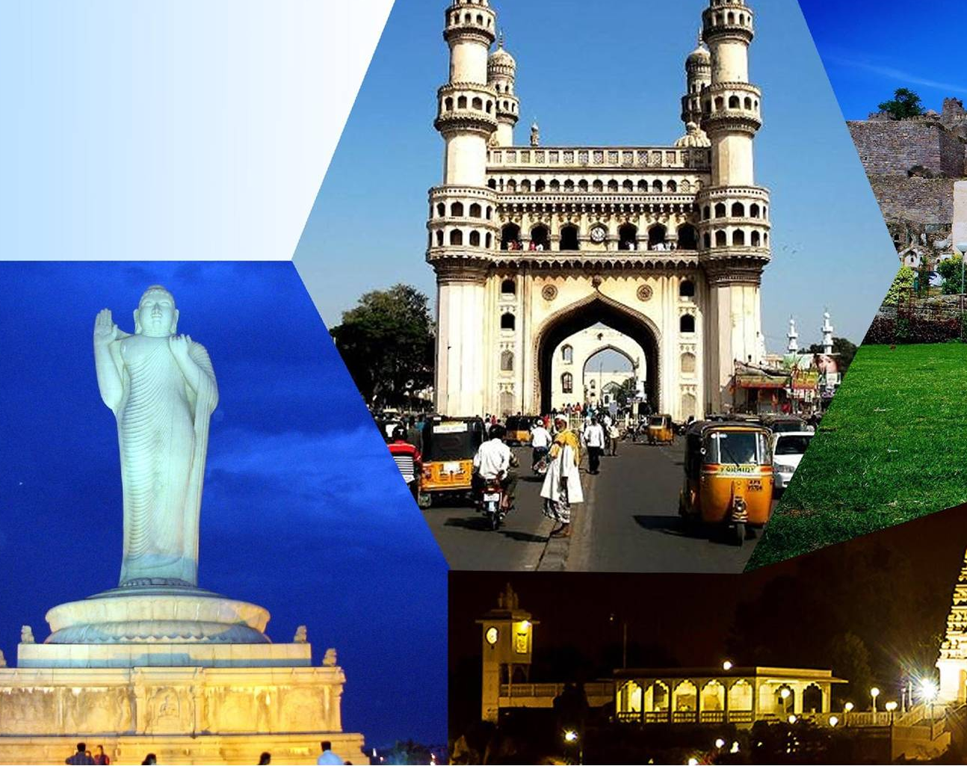

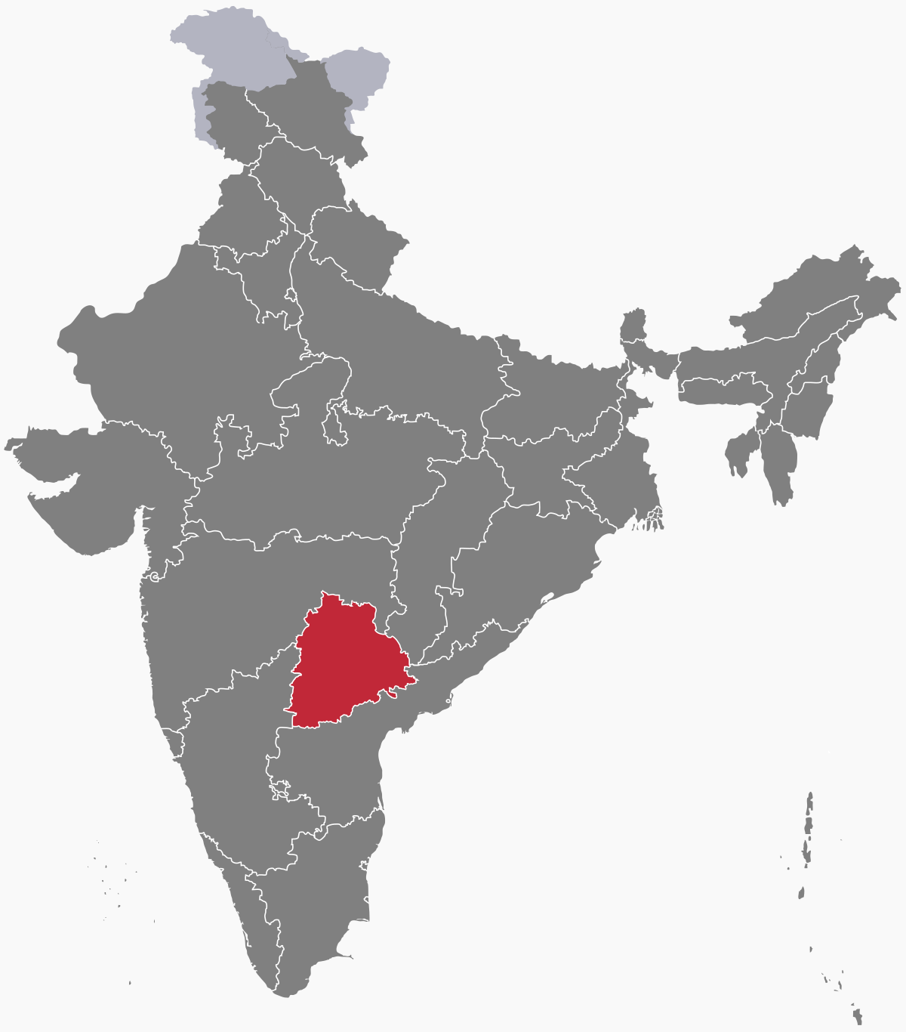
Provide Insights For Telangana Tourism Department
-By Sourav Patro

Slide 2
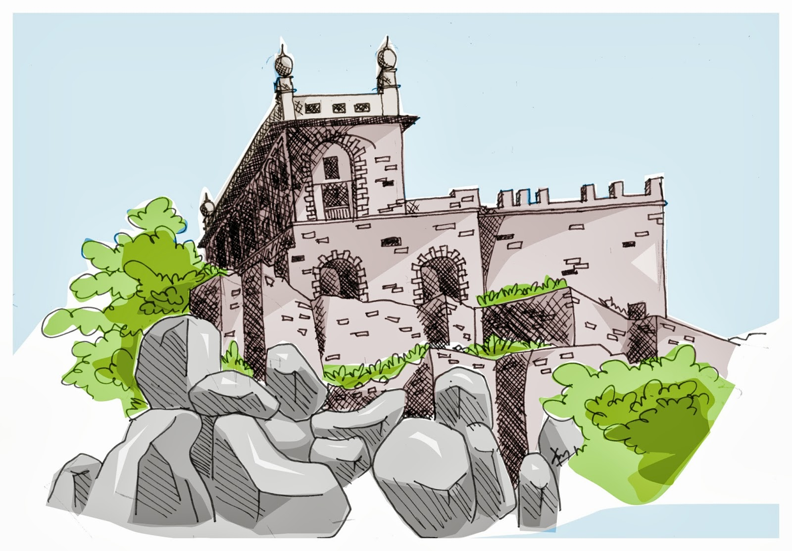
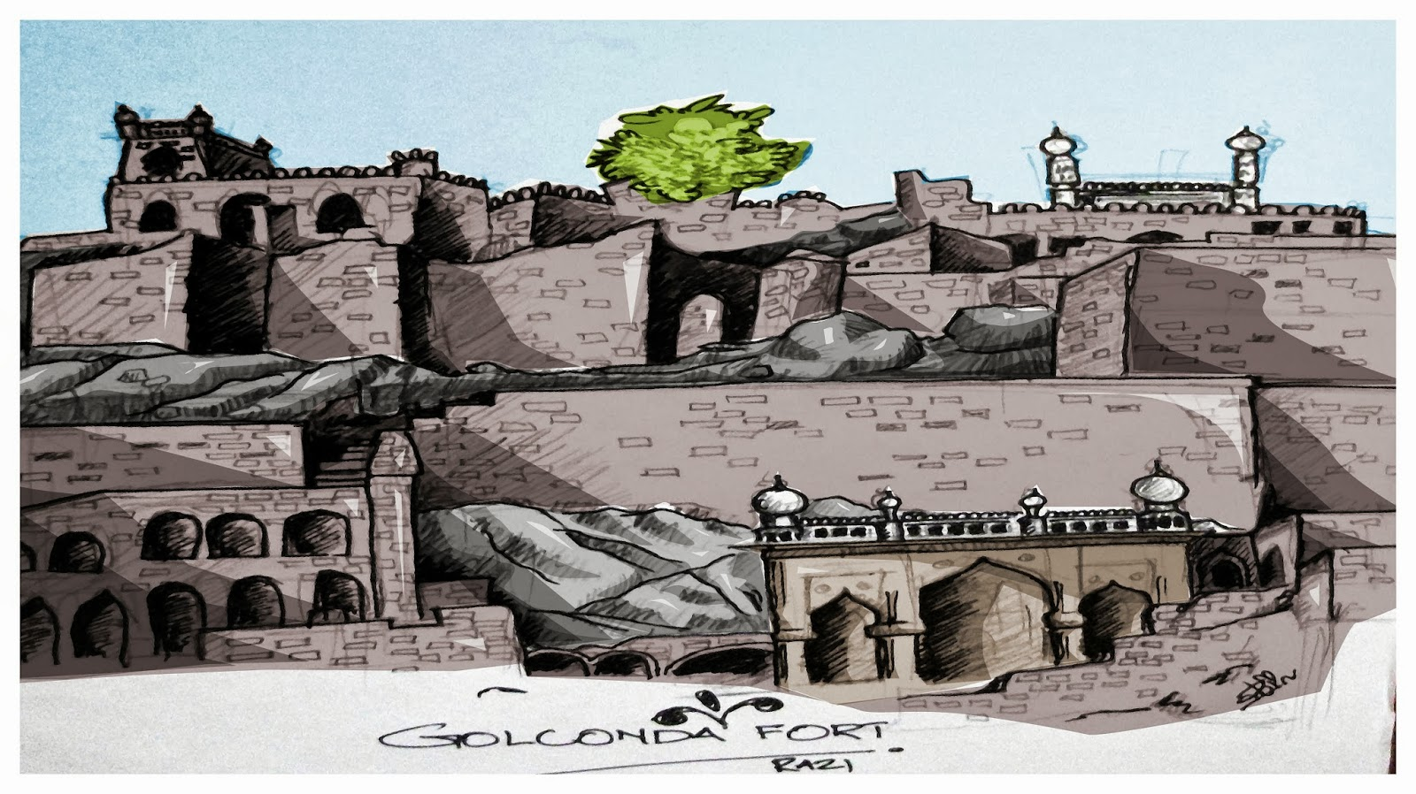
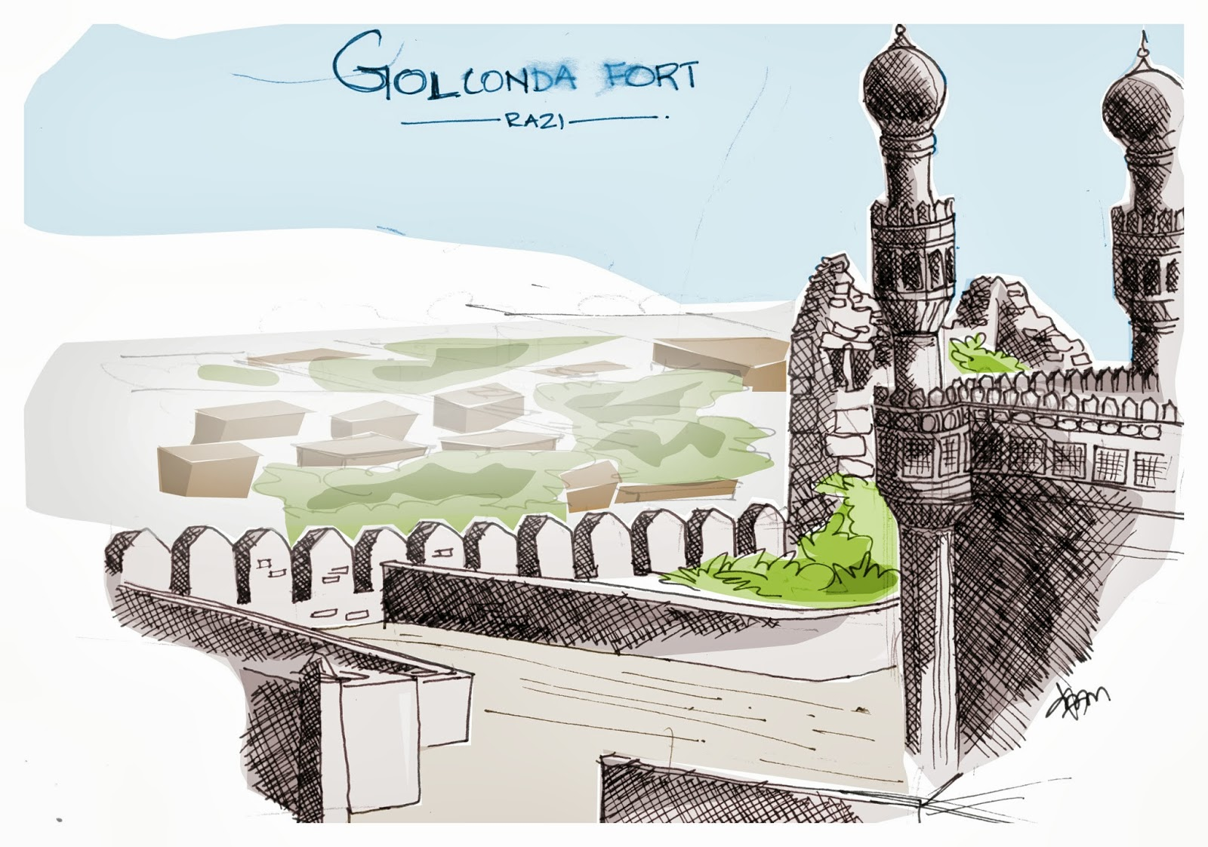
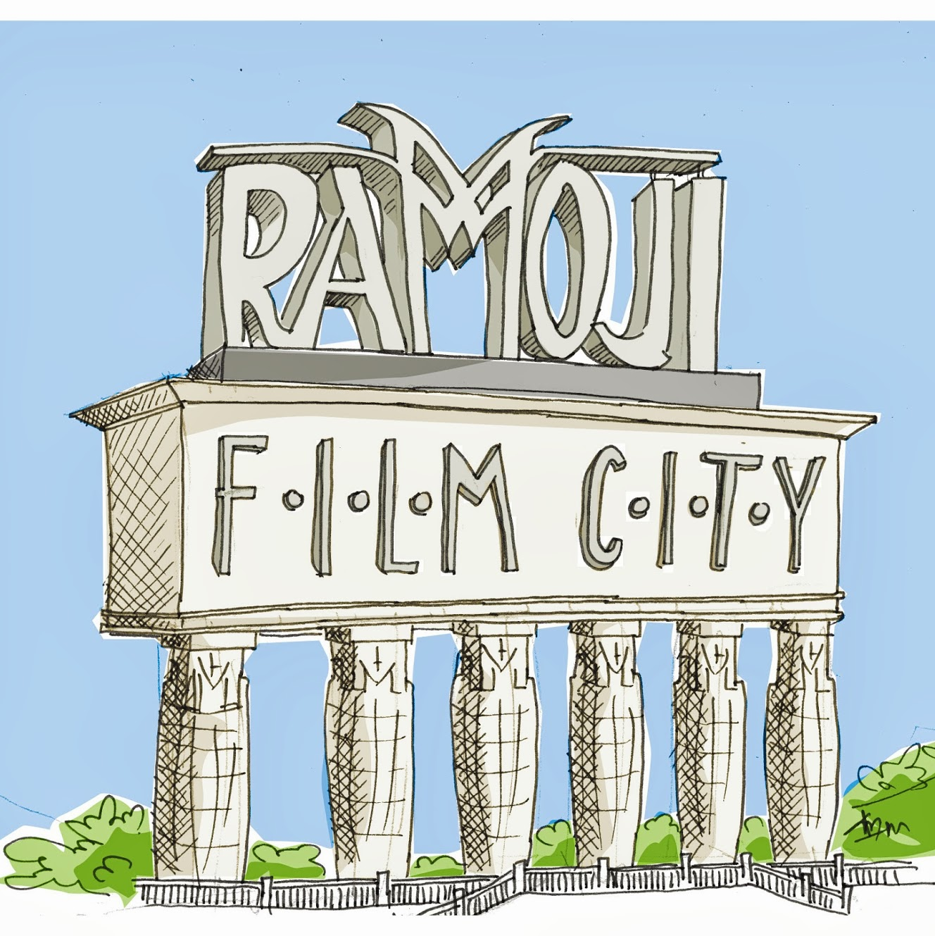
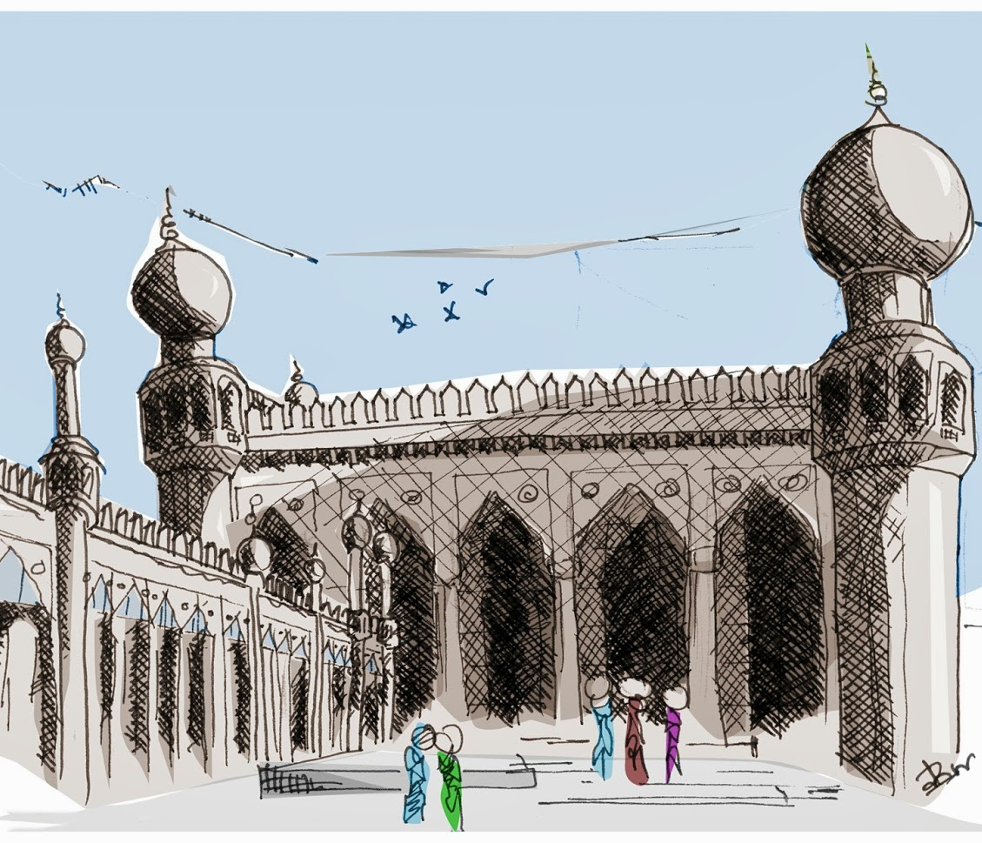
Agenda
01.Objective
02.Overview
03.Data, Additional Data
04.Trends & Insights
05.Opportunites & Challenges

Slide 3
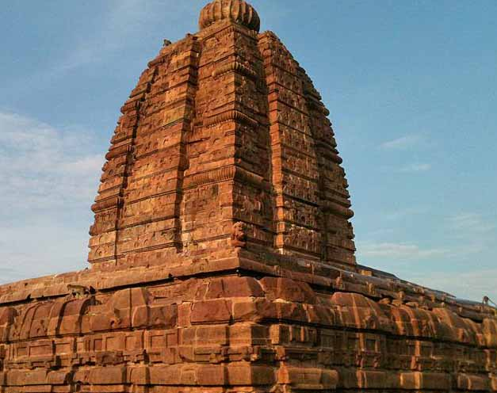
Objective
In this presentation, we'll delve into Telangana's tourism data from 2016 to 2019, using data-driven analysis to unveil key insights. Our goal is to present actionable strategies that will boost revenue and streamline administrative operations in the tourism sector. Leveraging the state's open data policy, we'll identify growth opportunities, optimize resources, and build a sustainable tourism industry. As a data analyst, my role is to provide data-informed recommendations to the Telangana government for enhancing revenue through improved administrative operations. Together, we can unlock the full potential of Telangana's tourism sector and propel it to new heights of success.

Slide 4
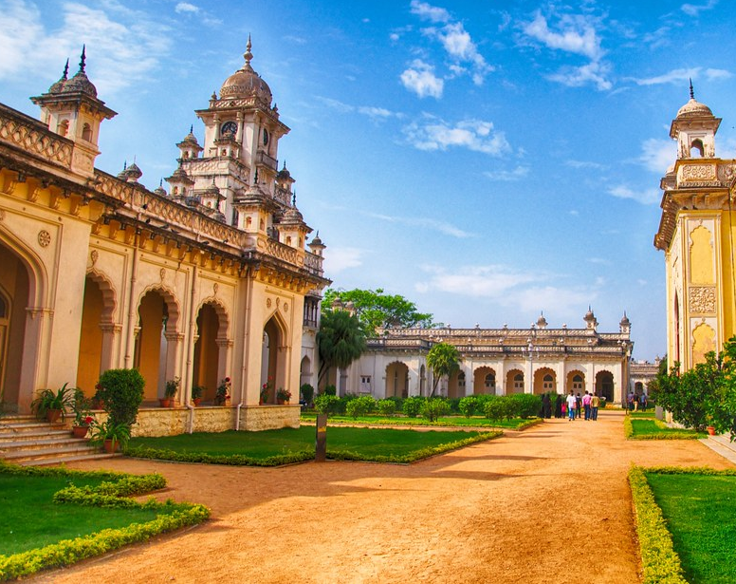
Overview
Telangana, located in southern India, boasts a diverse tapestry of cultural heritage and breathtaking natural landscapes. With an array of historical monuments, religious destinations, captivating natural attractions, and bustling urban centers, the state's tourism sector has experienced steady growth over the years. Visitors are drawn to the region's vibrant mix of history, spirituality, and picturesque settings, making Telangana a favored destination for both domestic and international travelers. Its rich offerings promise memorable experiences, contributing to the state's thriving tourism industry.

Slide 5
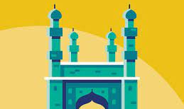
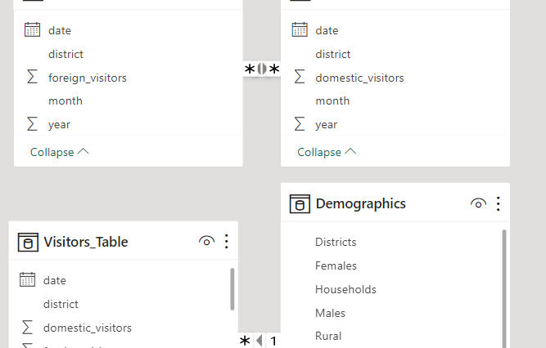
Data
Through an extensive analysis of domestic and foreign visitor data from 2016 to 2019, alongside Telangana's population demographics in 2011, we uncovered significant insights into tourism trends and their correlation with the region's population.
By merging and examining these datasets, we gained a comprehensive understanding of tourism patterns, allowing us to offer data-driven recommendations.
Our insights aim to foster the growth of Telangana's tourism industry while optimizing its impact on the state's population and economy.
With a focus on enhancing revenue and streamlining administrative operations, these recommendations will pave the way for a more robust and sustainable tourism sector in Telangana.

Slide 6
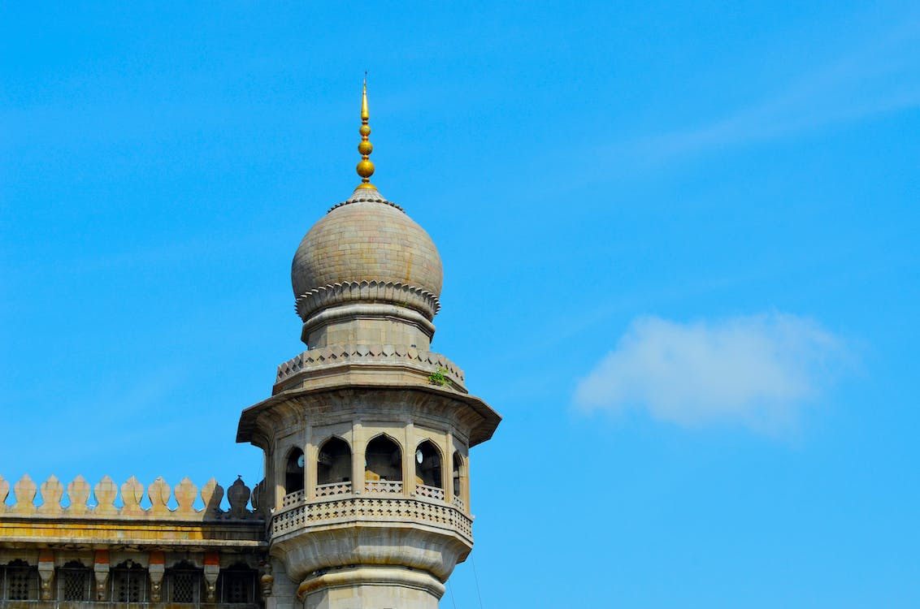
Additional Data
In addition to the domestic and foreign visitor data from 2016 to 2019, we gathered valuable information through extensive research on Telangana's tourism landscape.
The new dataset includes columns such as "area" (representing the area of each district), "population" (providing the district's population and population density), "road" (detailing major district roads, state highways, and rural roads), and "tourist spot" (indicating the number of tourist spots in each district, including TSTDC units).
Moreover, we acquired miscellaneous data points like literacy rate, urban and rural percentages, sex ratio, and the total number of villages in the state.
This comprehensive dataset will enable us to delve even deeper into the relationships between tourism patterns, infrastructure, and demographic factors, leading to more robust and insightful recommendations for the government.

Slide 7
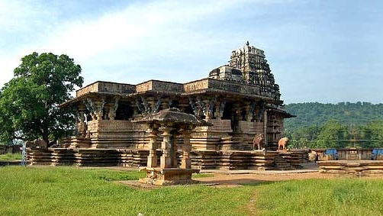
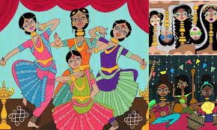
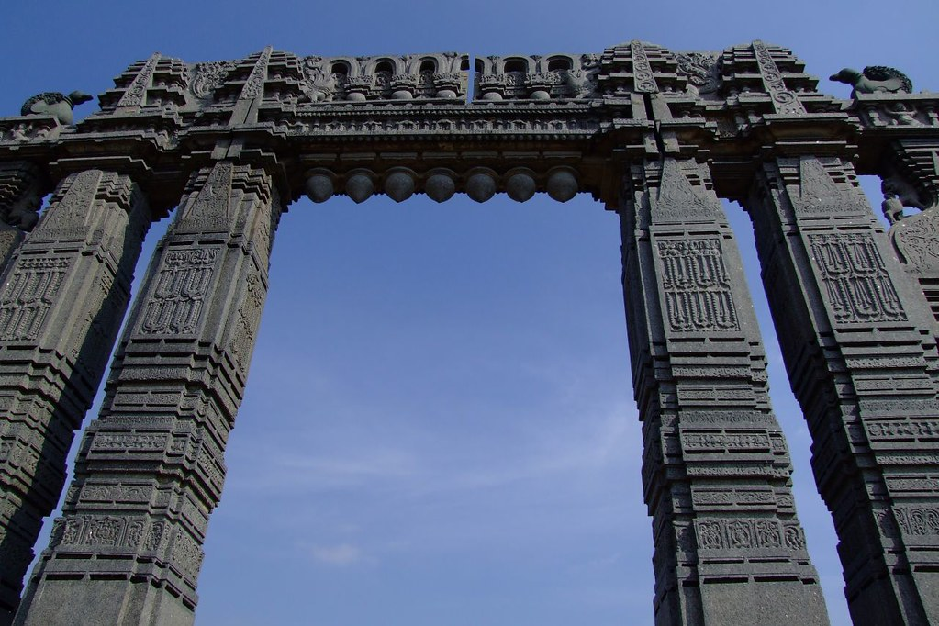
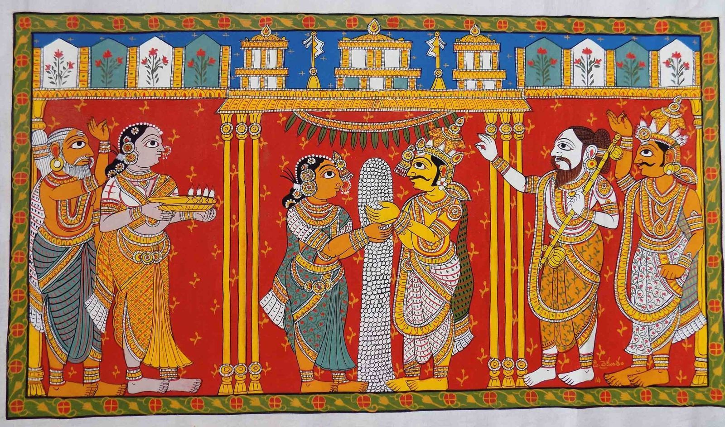
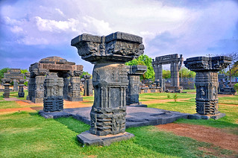
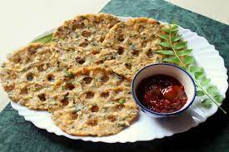
Trends & Insights

Slide 8
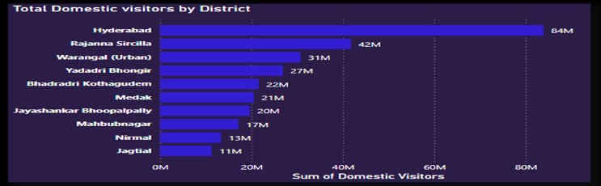
Understanding the Trends and Insights of Domestic Tourists in Telangana
Hyderabad, a vibrant city, boasts numerous historical monuments, serves as India's IT hub, and hosts the renowned Telugu film industry. The city is a melting pot of culture and innovation.
Rajanna Sircilla is acclaimed for its flourishing textile industry, contributing significantly to the region's economy and employment. The town's fabric craftsmanship is renowned far and wide.
Warangal, steeped in history, showcases an array of awe-inspiring architectural wonders, reflecting its glorious past. Its heritage sites stand as testaments to the rich cultural heritage of the region, attracting tourists and history enthusiasts from around the world.
Each of these cities plays a vital role in shaping Telangana's unique identity.

Slide 9
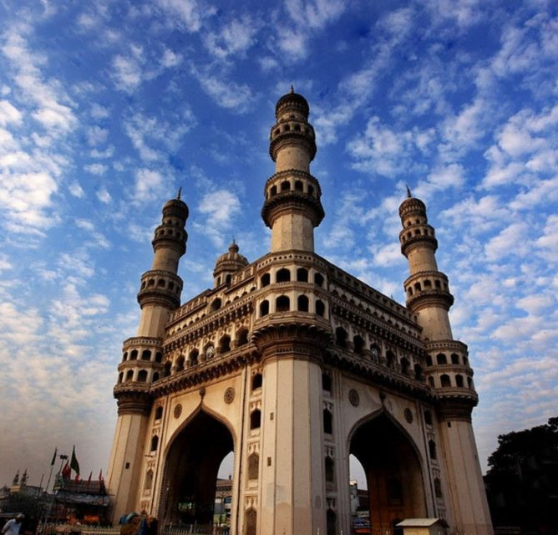
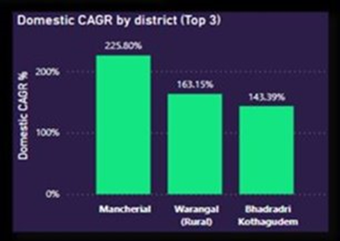
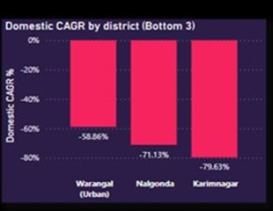
Mancherial thrives on coal mining, diverse industries, favorable agriculture climate, and robust infrastructure.
Warangal (urban) faces a slow CAGR due to limited industries, low agricultural yield, inadequate infrastructure, and minimal tourism.
Similarly, Karimnagar experiences a sluggish CAGR due to heavy reliance on agriculture, limited industrial growth, inadequate infrastructure, political instability, and low tourism prospects.

Slide 10
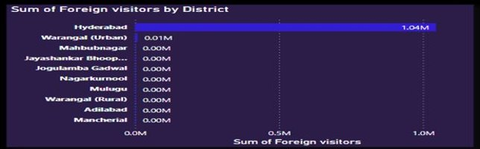
Understanding the Trends and Insights of Foreign Tourists in Telangana
Hyderabad has earned its popularity as a favored destination among foreign visitors owing to its captivating blend of rich history, vibrant culture, and its status as a thriving hub for business and IT companies.
Warangal, on the other hand, boasts a treasure trove of historical and architectural marvels, enticing travelers with its magnificent heritage.
Meanwhile, Mahbubnagar beckons tourists with an array of delightful attractions, including the scenic Koilsagar Dam, the enchanting Kollapur Palace, and the ancient allure of the Alampur Jogulamba Temple.
Each of these cities in Telangana, India, offers a unique and alluring experience for visitors.

Slide 11
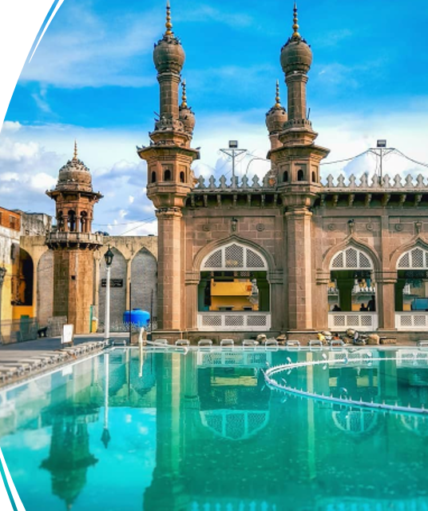
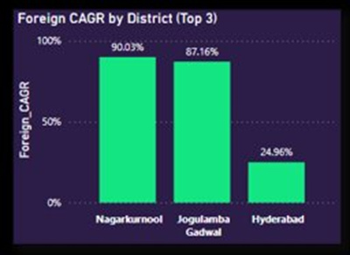
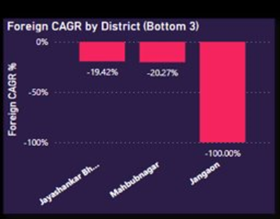
Nagarkurnool exerts a magnetic pull on foreign tourists with its breathtaking natural beauty, offering them an array of adventure tourism opportunities and the chance to explore its mesmerizing wildlife sanctuaries.
Meanwhile, Jogulamba Gadwal emerges as a sought-after destination for international visitors, enthralling them with its rich historical and cultural sites, showcasing unique handloom products, and being conveniently close to the vibrant city of Hyderabad.
However, Jangaon's potential as a tourist hotspot remains untapped due to several challenges, including limited attractions, inadequate infrastructure, poor marketing efforts, insufficient accommodation facilities, and a lack of basic amenities and reliable transport services, leading to a disappointing growth in its tourism sector.

Slide 12
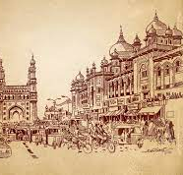
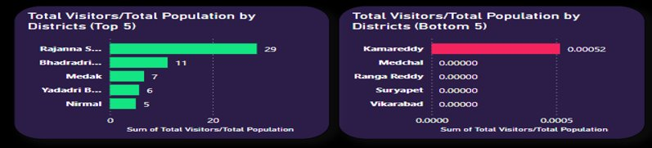
Hyderabad, a prominent economic and cultural hub in South India, stands as a magnet for both domestic and international tourists, allured by its enchanting historical landmarks and bustling business centers. The city's rich heritage and modern vibrancy create an irresistible appeal.
On the other hand, Mulugu, a district with a strikingly high ratio of domestic tourists to foreign tourists, owes its popularity to being a favored weekend getaway destination among locals, coupled with the presence of renowned Hindu temples that draw numerous visitors.
As for Nirmal, it exhibits the lowest Domestic to foreign tourist ratio, indicating relatively limited attraction for international travelers, while still maintaining some allure for domestic visitors.

Slide 13
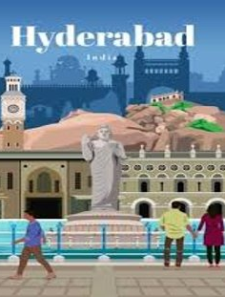
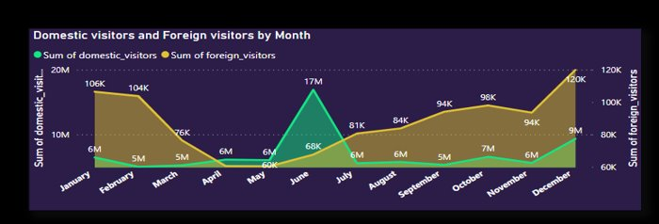
Analyzing Hyderabad
The peak months of foreign visitors in Hyderabad (December to February) are fueled by the pleasant winter weather, affordable airfare and hotel rates, and captivating events like the Hyderabad Literary Festival and International Kite Festival.
These factors create an enticing environment for international travelers to explore the city's rich cultural heritage. However, domestic tourism experiences a lull in February and March due to the hot and dry weather, while September sees a decline due to monsoon disruptions and school schedules.
Despite the challenges, Hyderabad's charm remains a major draw for both foreign and domestic tourists, with its unique blend of history, culture, and modernity.

Slide 14
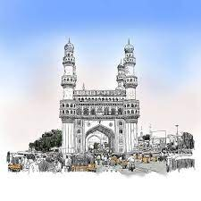
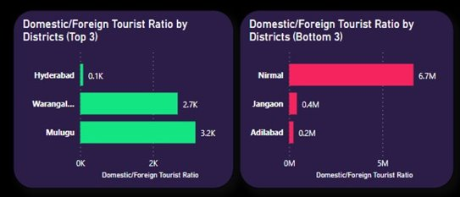
Rajanna Sircilla experiences a significant population-to-tourist footfall ratio, owing to its flourishing handloom industry, prominent attractions like the Kargil Park and the historical Sircilla Fort, and a sizable local population that contributes to tourist interest. Similarly, Bhadradri Kothagudem enjoys a substantial influx of tourists due to the presence of the Kothagudem Thermal Power Station and the alluring Kinnerasani Wildlife Sanctuary, further augmented by its own sizable population.
However, Kamareddy, Medchal, Ranga Reddy, Suryapet, and Vikarabad present a different scenario, exhibiting a relatively low population-to-tourist footfall ratio. This can be attributed to their limited tourist attractions, inadequate infrastructure, and basic amenities. These regions, though possessing their own unique charm, may lack the widespread appeal and facilities that draw a larger number of visitors.

Slide 15
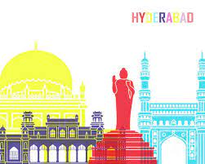
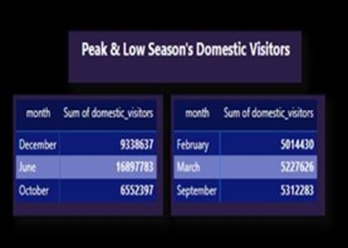
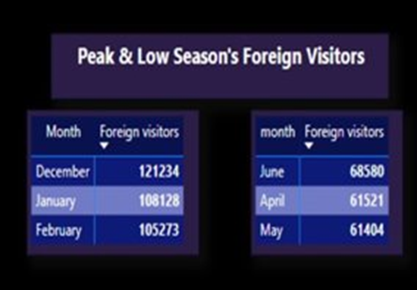
Hyderabad experiences a surge in foreign visitor arrivals during the months of December, January, and February, primarily due to the city's pleasant weather, vibrant cultural events, and festive celebrations. The holiday season in numerous countries also contributes to the increased appeal for international tourists during this period.
Conversely, the months of May, April, and June witness a decline in foreign tourist footfall, as the hot and humid weather makes these months less attractive for travel. Moreover, these months coincide with summer holidays in many countries, prompting a decrease in foreign visitors to Hyderabad.

Slide 16
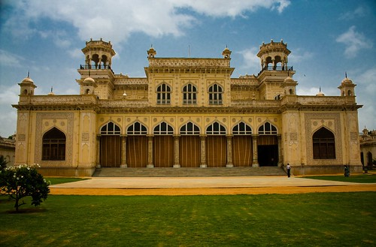
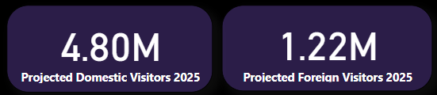
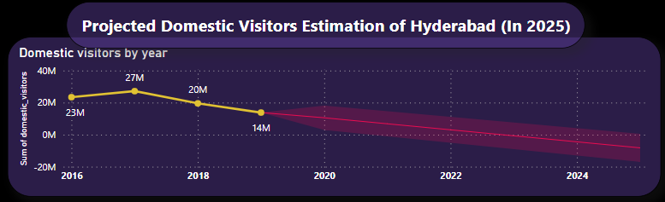
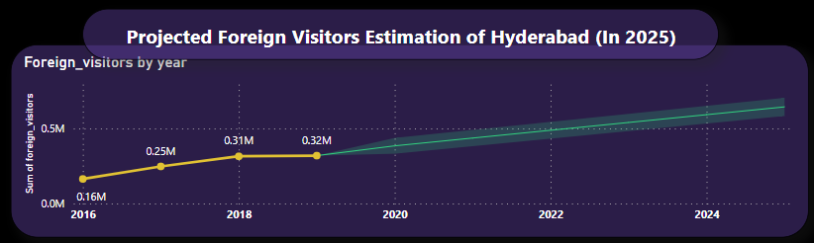
In the year 2025, Hyderabad is expected to receive around 4.80 million domestic tourists, with a projected annual growth rate of -4.44%.
01
Concurrently, the number of foreign tourists visiting the city is estimated to be approximately 1.22 million, reflecting a substantial foreign annual growth rate of 24.74%.
02
These projections signify a mixed trend, with a decline in domestic tourist numbers while foreign tourism shows promising growth, highlighting Hyderabad's increasing allure on the international stage.
03

Slide 17
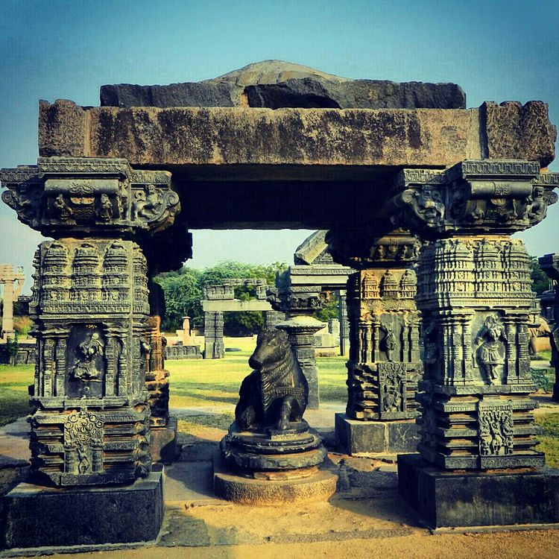
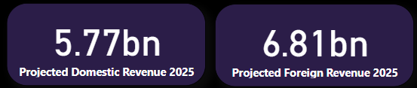
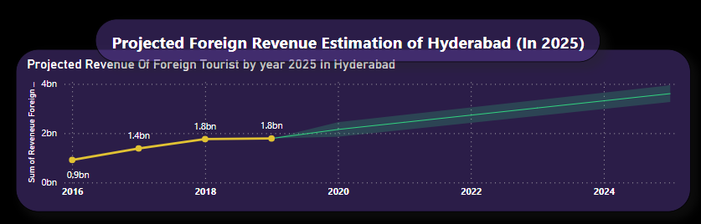
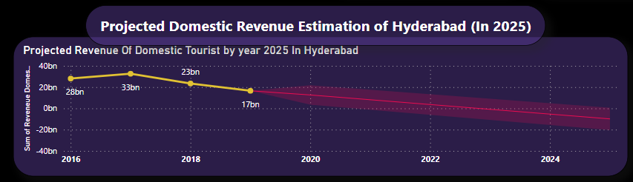
In the year 2025, Hyderabad's projected domestic tourism revenue is expected to reach 5.77 billion, showcasing the substantial financial contribution from local visitors.
01
Simultaneously, the city's estimated foreign tourism revenue is projected to surge to 6.82 billion, indicating a significant boost from international travelers.
02
These revenue projections underscore the city's growing significance as a tourism destination, with both domestic and foreign visitors contributing significantly to its economic prosperity.
03

Slide 18
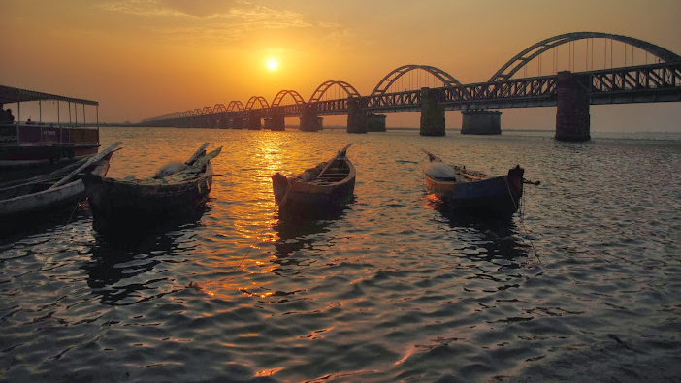
Opportunities & Challenges

Slide 19
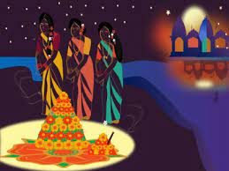
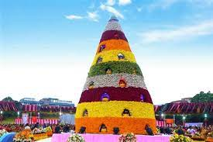
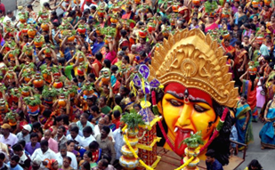
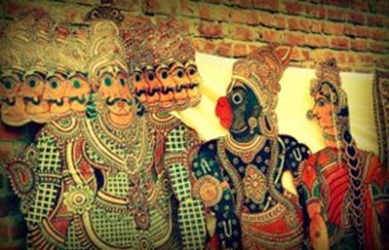
Hyderabad hosts the vibrant Bathukamma Festival in September or October, celebrating the essence of Telangana's culture and traditions. In February, the Deccan Festival takes center stage, captivating visitors with its artistic showcases and colorful performances.
Meanwhile, Medaram and Mulugu come alive during January or February with the grand Sammakka Saralamma Jatara, drawing countless devotees to partake in this significant religious event.
In April, Nizamabad embraces the delightful Telangana Food and Art Festival, enticing visitors with an array of delectable cuisines and showcasing the region's rich artistic heritage. Each of these festivals offers a unique opportunity to experience the diverse cultural tapestry of Telangana.

Slide 20
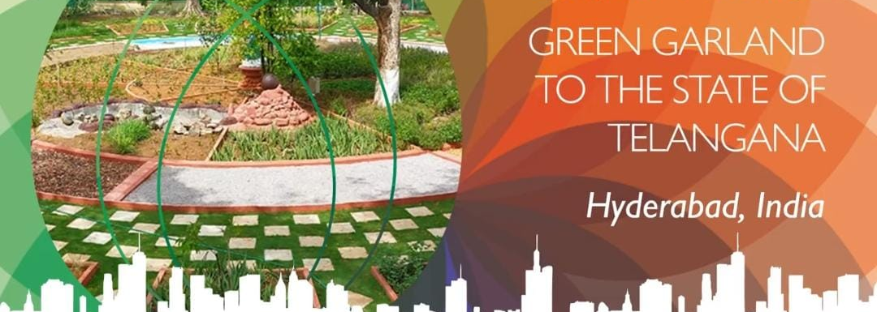
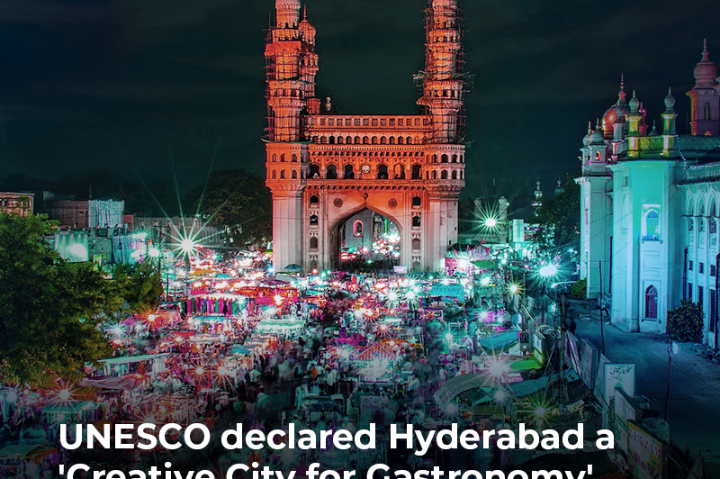
In April, Nalgonda hosts the Telangana Trade and Export Fair, providing a platform for businesses to showcase their products and explore potential export opportunities. In August, the Telangana Business Networking Gala takes place in Medak and Hyderabad, facilitating valuable connections and collaborations within the business community.
Come September or October, Hyderabad hosts the prestigious Telangana Global Investors Summit, attracting investors from around the world to explore investment prospects in the state.
For agri-tech enthusiasts, the Telangana Agri-Tech Expo is held in Karimnagar, Warangal, and Hyderabad, offering a chance to explore innovative agricultural technologies during February, April, or June. Each of these events contributes to Telangana's economic growth and fosters business and technological advancements in the region.

Slide 21


Dubai boasts world-class infrastructure, including modern airports, transportation networks, luxury hotels, shopping malls, and entertainment facilities, ensuring convenience and comfort for tourists.
The city offers diverse tourism offerings, catering to various interests and preferences, from luxury shopping and dining experiences to desert safaris and thrilling water sports adventures.
Tourists can enjoy a duty-free shopping experience in numerous malls and markets, providing a vast selection of international brands and products.
Dubai prioritizes safety and security, with low crime rates, efficient law enforcement, and strict regulations to ensure the well-being of visitors.
The city implements effective marketing and promotion strategies to attract tourists from around the globe.
As a global transit hub, Dubai enjoys direct flights from various destinations, making it highly accessible and convenient for travelers to explore the city and beyond.

Slide 22

Strategies
Build Infrastructure
Develop and maintain iconic landmarks and attractions
Diverse tourism offerings
Marketing and Promotion
Enhancing Safety & Security

Slide 23


Thank you!

